Slide 1

Introduction to Web API

Slide 2
Definition of Web API: Web API is a framework for building HTTP-based services that enable communication and data exchange between different applications over the web
Key Features and Benefits: Web API simplifies communication between client and server applications, follows REST principles, supports multiple data formats , and enhances security through authentication and authorization mechanisms

Slide 3

HTTP and REST
HTTP is the foundation of web communication
Web API follows RESTful architecture, which uses standard HTTP methods and URIs to manipulate resources

Slide 4

Web API and Client-Server Communication
Web API serves as the server-side component, allowing client applications to send HTTP requests and receive responses
This enables seamless communication and data exchange between client and server

Slide 5
JSON and XML in Web API
Web API commonly uses JSON or XML as data formats for exchanging information between client and server

Slide 6
Creating a Web API
Building Web API with
NET involves developing controllers, defining routes, working with data models, and handling serialization for data exchange

Slide 7

RESTful Web API Design
Following best practices for RESTful design, such as proper resource naming, versioning, and handling HTTP status codes, helps ensure a well-designed and maintainable Web API

Slide 8
Web API Security
Web API supports various security mechanisms, including authentication, authorization, and securing sensitive data, to protect against unauthorized access and common security threats

Slide 9

Web API Documentation
Comprehensive documentation is essential for Web API
Tools like Swagger and OpenAPI help generate documentation, making it easier for developers to understand and consume the API

Slide 10
Web API Testing
Testing Web API involves unit testing, integration testing with client applications, and utilizing test automation and tools for efficient and reliable testing

Slide 11

Real-world Use Cases
Web API finds application in various scenarios, including social media integration, payment gateways, weather data APIs, and more

Slide 18
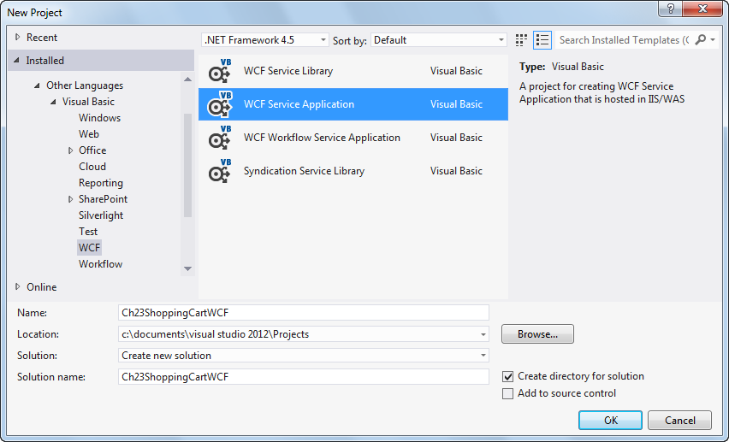
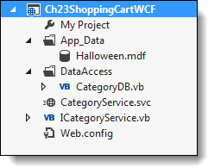

Slide 25
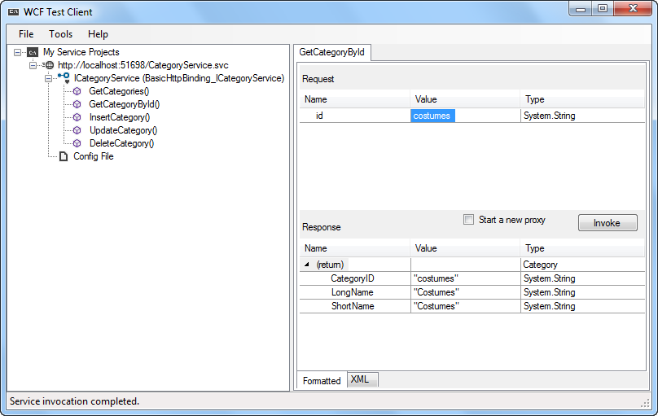

Slide 28
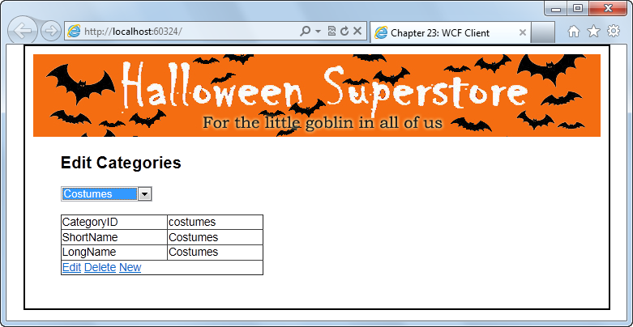

Slide 29
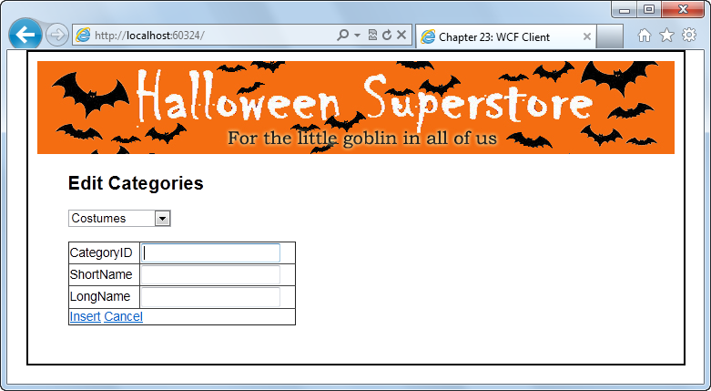

Slide 31
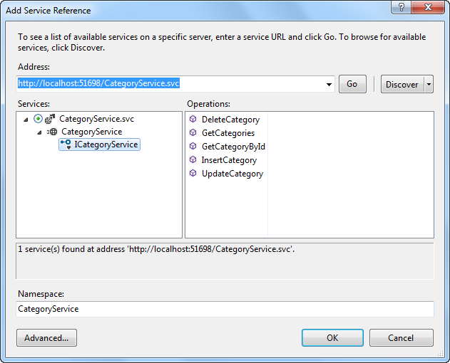

Slide 37
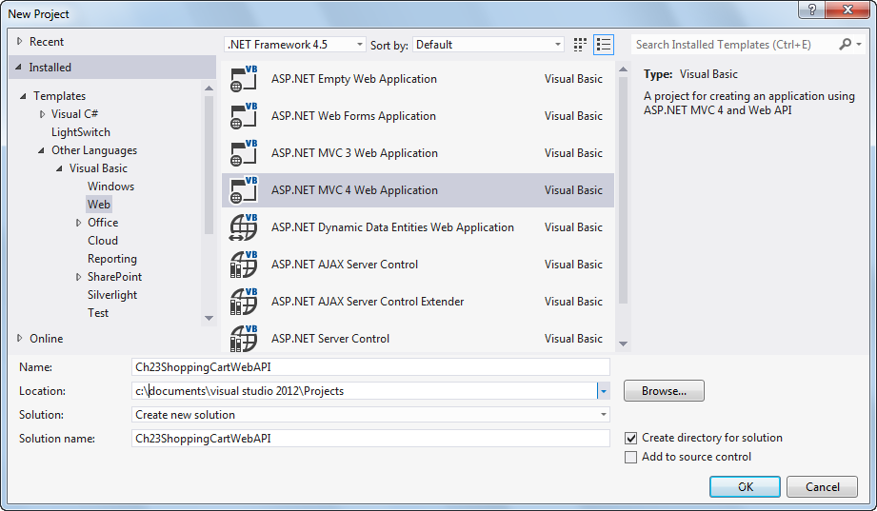
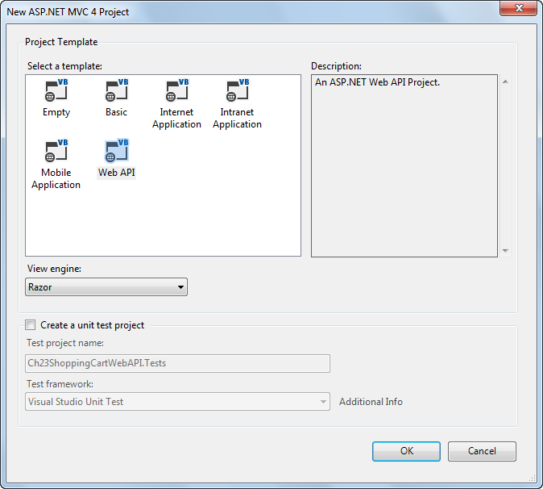

Slide 44
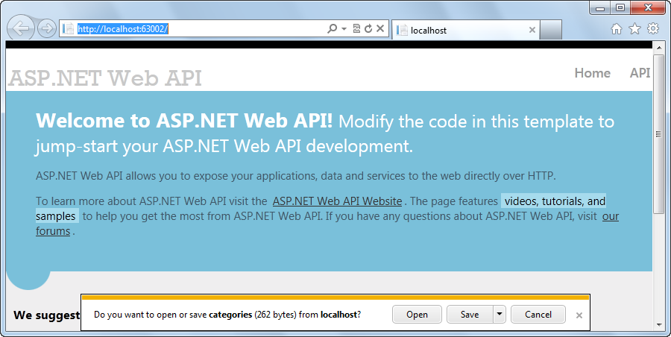
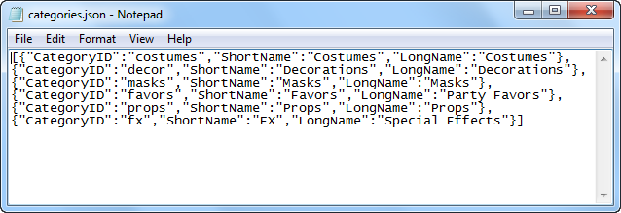

Slide 47
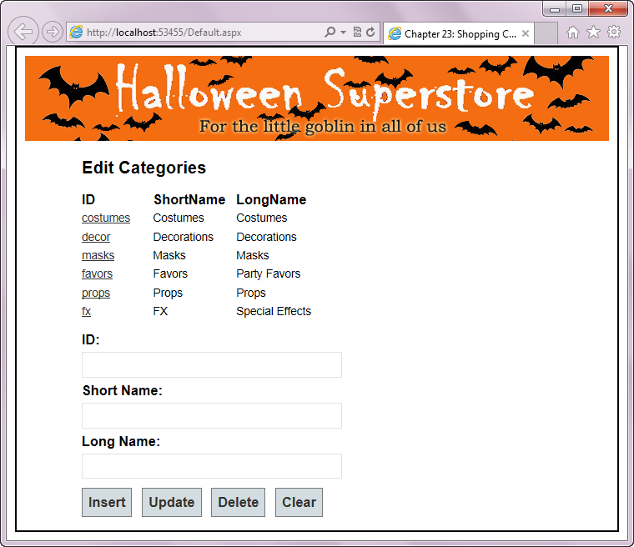

Slide 53
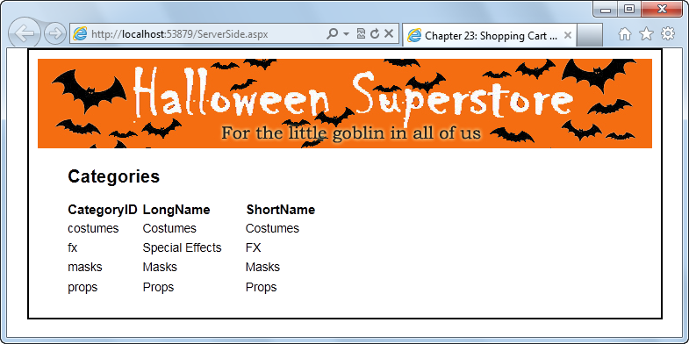

Slide 56
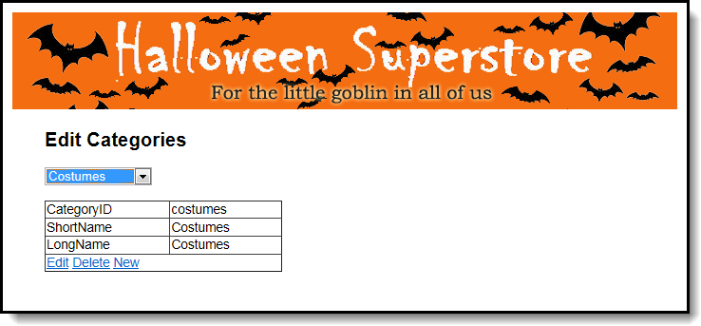

Slide 57
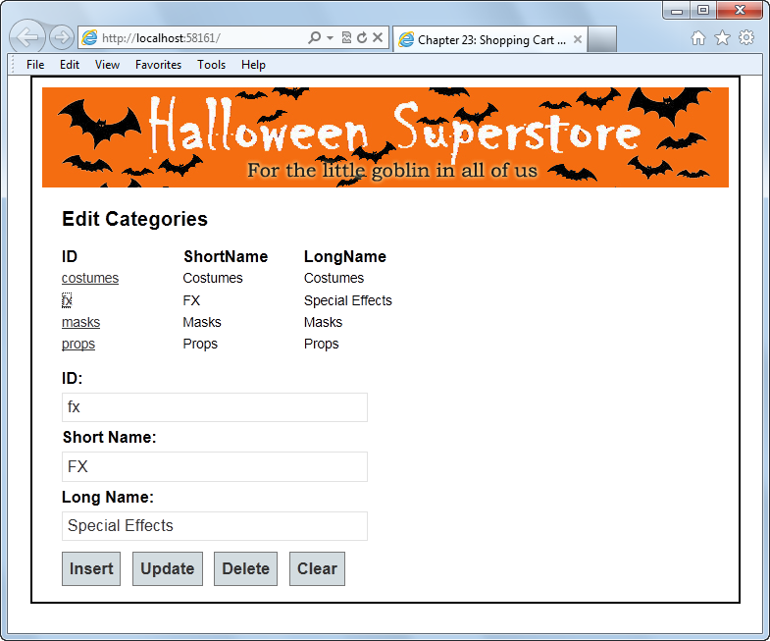

Slide 58

Advantages and Challenges of Web API
Web API offers advantages like cross-platform communication, but also presents challenges that need to be considered, such as security and versioning

Slide 59

Conclusion
Web API is a powerful framework for building HTTP-based services, enabling seamless communication and data exchange between applications
It revolutionizes web development and opens up possibilities for creating innovative and interconnected applications

Slide 60

Q&A
Any questions?

